Slide 1
CHEM 102
SECTION A
TOPIC KINETIC THEORY OF GASES

Slide 2
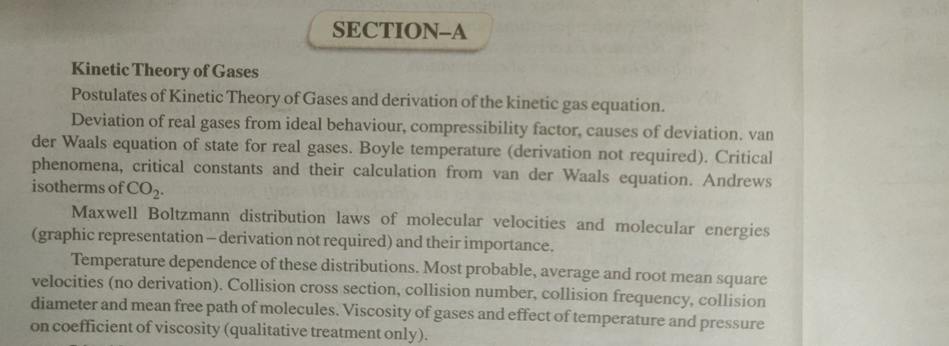
TOPIC TO BE STUDIED
As per syllabus

Slide 3
Postulates of kinetic theory of gases
All gases are made up of large number of small molecules of identical size,shape and mass
Actual volume occupied by molecules is negligible as compared to the volume of the gas.
There are no attractive forces between the molecules of the gas .
The molecules are in a state of ceaseless and random motion .
The collision of molecules amongst themselves and with the walls of the container are perfectly elastic.
The pressure of the gas is due to collisions of molecules against the walls of the container.
The molecules possess different K.E ,but average K.E is directly proportional to the temperature.
The motion of molecules is unaffected by force of gravitation.

Slide 4
Implications of Postulates of Kinetic theory of gases
i) Particles
Gas is a collection of a large number of atoms or molecules.
ii) Point Masses
Atoms or molecules making up the gas are very small particles like a point(dot) on a paper with a small mass.
iii) Negligible Volume Particles
Particles are generally far apart such that their inter-particle distance is much larger than the particle size and there is large free unoccupied space in the container. Compared to the volume of the container, the volume of the particle is negligible (zero volume).
iv) Nil Force of Interaction
Particles are independent. They do not have any (attractive or repulsive) interactions among them.
v) Particles in Motion
The particles are always in constant motion. Because of lack of interactions and the free space available, the particles randomly move in all directions but in a straight line.
vi) Volume of Gas
Because of motion, gas particles, occupy the total volume of the container whether it is small or big and hence the volume of the container to be treated as the volume of the gases.
vi) Mean Free Path
This is the average distance a particle travels to meet another particle.
vii) Kinetic Energy of the Particle
Since the particles are always in motion, they have average kinetic energy proportional to the temperature of the gas.

Slide 5
KINETIC GAS EQUATION FROM Postulates of Kinetic Theory of gases
Consider a cubic box of length l filled with the gas molecule of mass m, moving along the x-axis with velocity v_{x} Therefore its momentum is mv_{x}.
The gas molecules collide the walls. At face 1, it collides and the gains momentum mv_{x}.
Similarly, the molecules collide face 2, reversing the momentum i.e., -mv_{x}.
Thus, the change in the momentum is given by
Δp = mv_{x}-(-mv_{x}) = 2mv_{x}—–(1)
After the collision, the molecule travels a distance of 2l before colliding again with face 1.
The total collisions on wall1 in one second =v_{x} /2l
Change of momentum of molecule due to collision with face 1 in one second =2mv_{x} . v_{x}/2l = mv_{x}²/2l
Similarly change of momentum of molecule due to collision with face 2= mv_{x}²/2l
Total change in momentum = mv_{x}²/2l + mv_{x}²/2l = 2 mv_{x}²/2l
Total change in momentum on all six faces = 2mv²/l
For n molecules having velocities v1,v2,v3………..vn it will be
2mnu²/l where u is the root mean square velocity. Contd…

Slide 6
KINETIC GAS EQUATION
Since rate of change of momentum is force ,so
2mnu²/l =F
Pressure = force /area and area= 6l²
So Pressure = 2mnu²/l × 1/ 6l²
⁼ mnu²/3l³
P = mnu²/3V This can be written as
PV= 1/3 × mnu2
This expression is called KINETIC GAS EQUATION.

Slide 7
DEVIATION FROM IDEAL BEHAVIOUR
The causes of deviations from ideal behaviour may be due to the following two faulty assumptions of kinetic theory of gases.
The volume occupied by gas molecules is negligibly small as compared to the volume occupied by the gas.
The forces of attraction between gas molecules are negligible.

Slide 8
Correction for Volume
(Faulty assumption 1)
The volume of a real gas is therefore larger than expected from the ideal gas equation at high pressures.
Van der Waals proposed that we correct for the fact that the volume of a real gas is too large at high pressures by subtracting a term from the volume of the real gas before we substitute it into the ideal gas equation. He therefore introduced a constant (b) into the ideal gas equation that was equal to the volume actually occupied by a mole of gas particles.
Because the volume of the gas particles depends on the number of moles of gas in the container, the term that is subtracted from the real volume of the gas is equal to the number of moles of gas times b.
P(V - nb) = nRT
When the pressure is relatively small, and the volume is reasonably large, the nb term is too small to make any difference in the calculation.
But at high pressures, when the volume of the gas is small, the nb term corrects for the fact that the volume of a real gas is larger than expected from the ideal gas equation.

Slide 9
How to calculate the excluded volume or covolume “b”
The volume of a gas is the free space in the container in which molecules move about. Volume V of an ideal gas is the same as the volume of the container. The volume of a real gas is, therefore, ideal volume minus the volume occupied by the gas molecules themselves. If V_{m} is the volume of the single molecule then, the excluded volume which is termed as "b" is determined as follows. (next slide)

Slide 10
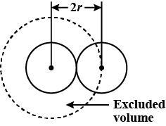
Calculation of excluded volume
Let us consider two colliding molecules with radius `r'. The space indicated by dotted sphere of radius 2r will not be available for other molecules to freely move about. (i.e) the dotted spherical volume is known as excluded volume per pair of the molecules.
Thus,
excluded volume for two molecules = 4/3 x pi (2r) ³
=8( 4/3 pi r ³ )
Excluded volume per molecule
VC = 1/2 x 8 x 4/3 x pi r³ = 4 x 4/3 x pi r³ = 4 Vm
where Vm is the actual volume of a single molecule.
The excluded volume for n molecules, 'b' = 4n Vm, where 4 Vm is the excluded volume of a molecule.
The corrected volume of the real gas is = (V-b) = free space for molecular movement.
b is called VanderWaals constt.

Slide 11
Correction for Pressure
(Faulty assumption 2)
The assumption that there is no force of attraction between gas particles cannot be true. If it was, gases would never condense to form liquids. In reality, there is a small force of attraction between gas molecules that tends to hold the molecules together. This force of attraction has two consequences: (1) gases condense to form liquids at low temperatures and (2) the pressure of a real gas is sometimes smaller than expected for an ideal gas.
To correct for the fact that the pressure of a real gas is smaller than expected from the ideal gas equation, van der Waals added a term to the pressure in this equation. This term contained a second constant (a) and has the form: an²/V².

Slide 12
How to calculate Pressure correction
Gaseous pressure is due to the force with which the molecules strike the walls of container.
A molecule striking the wall experiences backward drag and and strike with less force.So observed pressure is less than the ideal.Hence correction term is to be added to the observed pressure to make it equal to ideal
Pi = P+p,where p is the correction term and it depends on:
No of molecules per unit volume in the bulk of gas (n/v)
No of molecules striking the wall per unit area at any given time. (n/v)
So correction term p= n/v× n/v = a (n/v)²
Where a is a constant called Vanderwaal constt
Hence Pi = P + an²/v²

Slide 13
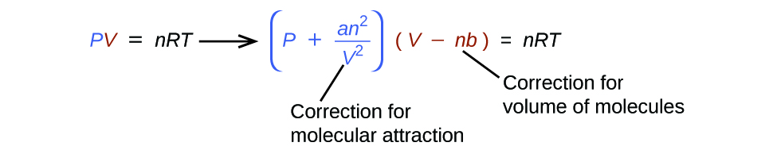
Vanderwaals Equation and Sinificance of constts “a” and “b”
Physical significance of ‘a’ : It measures the magnitude of intermolecular attractive forces between the particles.
Physical significance of ‘b’: It measures the volume excluded by a mole of particles.Also called covolume or excluded volume ,it measures the effective size of the molecules.

Slide 14
Units of Vanderwaals constt
Show that the CGS unit of vanderwaals constt a is atm lt² mol⁻²
What are the SI units of vanderwaals constt a
SI unit of Vanderwaals constt b is………………..
Units of vanderwaals constt b lt/mol are CGS UNITS(T/F)

Slide 15
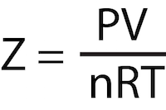
THANX
KINDLY STUDY ABOUT COMPRESSIBILITY FACTOR FROM YOUR PREVIOUS CLASS BOOKS SO THAT YOU CAN BETTER UNDERSTAND THE NEXT LECTURE ON “Behaviour of real gases on the basis of VANDERWAALS EQUATION.”

